Slide 1


DBS Day 1
John Cabibbo
jcabibbo@fullsail.com
AIM: jcabibbo@fullsail.com

Slide 2
Day Overview
Introduction to Databases
Types of Databases
Data Types
Basic Constraints
Keys & Relationships
CRUD - Create, Read, Update and Delete
SQL Dump

Slide 3
What is a DB (Database)?
Why do we need one? Why not use a text file?
What are the benefits?
Performance
Consistency
Availability
Portability
Security
How was data stored?
Disk, tape, floppy, card.

Slide 4
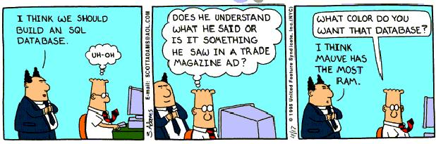
DBS

Slide 5
Relational Databases
Data is stored in tables
Developed in the 70’ & 80’s.
Tables are composed of rows and columns.
Tables are related to other tables through “relationships”
My SQL
Oracle
MS SQL Server

Slide 6
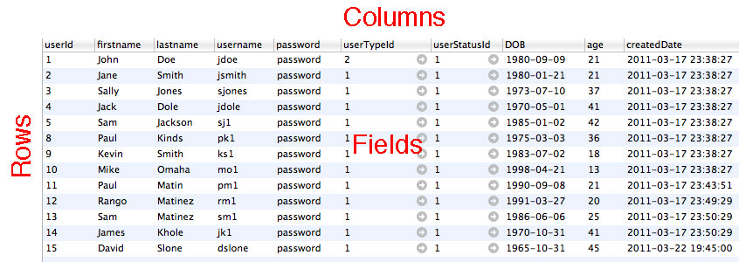
Database Objects
Tables, Rows, Columns & Fields

Slide 7
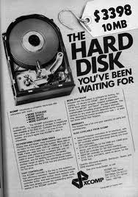
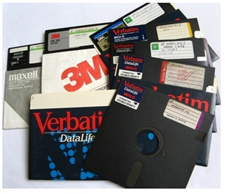
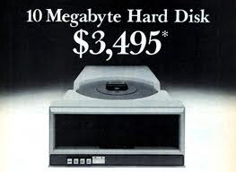

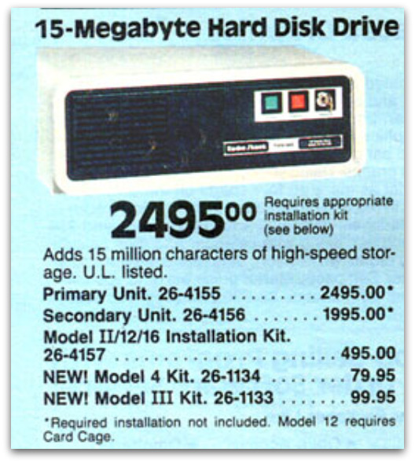
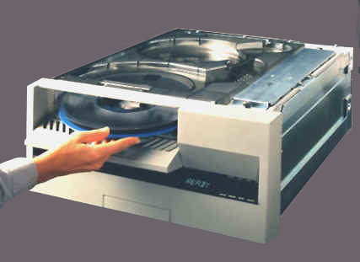
Relational Databases

Slide 8
Non-Relational Databases
Data is stored documents.
Relationships are not defined.
Benefits:Performance
Cons:Disk Space
Apache Cassandra
Mongo
Big Table

Slide 9





Non-Relational Databases

Slide 10
Install GITHUB
Register at https://github.com/
Download the GitHub software.
Email your username to jcabibbo@fullsail.com and I will share the DBSXXXX repo.
All labs MUST be submitted through GitHub.

Slide 11
Using MySQL
Startup MAMP
Download & Install Sequel Pro
http://www.sequelpro.com/
MySQL Workbench
http://wb.mysql.com/
PHPMyAdmin (http://localhost:8888/MAMP/)

Slide 12
Create a Database
Create a DB named “exampleXXXX” through Sequel Pro
Import the MySQL dump file (dbs_database.sql).
In Sequel pro, select the new database then drag the file (dbs_database.sql) into the window.
At the bottom right, click the down arrow and select RUN ALL QUERIES. (This may take a few minutes.)

Slide 13
Table Structure

Slide 14
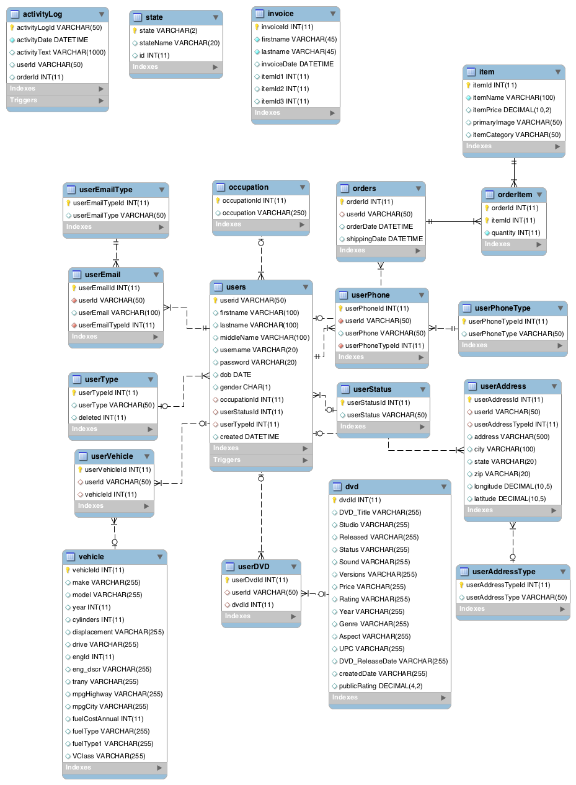

Slide 15
Data Types
Field Data Types:
Char (Set Length)
Varchar (Variable)
Int
Decimal
Date, Datetime
Text
SmallInt or Bit (0 or 1)
many more…
Reference: http://www.peachpit.com/articles/article.aspx?p=30885&seqNum=7

Slide 16
Basic Constraints
What is the definition of a constraint?

Slide 17
Basic Constraints
What is the definition of a constraint?
Something that limits or restricts someone or something
Control that limits or restricts someone's actions or behavior

Slide 18
Types of Constraints
Primary Key
Must be unique
Data is indexed
Data type: int & varchar
Foreign Key
Points to a primary key
Forces Values
A key can be a single column or a composite key of multiple columns

Slide 19
Keys & Relationships
Address Book

Slide 20
Keys & Relationships

Slide 21
Cable Listing Example
From FSO – Download cableRawData.sql
Drag the file into Sequel Pro – Query window.
Using Sequel Pro, separate the data into 3 tables.

Slide 22
Cable Listing Example

Slide 23
SQL Standards
SQL 2011 is the seventh revision of the ISO (1987) and ANSI (1986) standard for the SQL database query language.
Between MySQL, SQL Server and Oracle, the language is 98% compatible.

Slide 24
CRUD in SQL
Structured Query Language
There are 4 basic SQL commands:
Select
Insert
Update
Delete
Others: Create, Alter, Drop, Truncate

Slide 25
SQL: Select
Select firstname, lastname from users;
Select * from users where username = ‘jdoe’;
Select * from users where DOB< ‘1999-01-01’;

Slide 26
SQL: Select Join
Select firstname, lastname, userEmail
from users
join userEmail
on userEmail.userId = users.userId

Slide 27
SQL: Insert
insert into users
(firstname ,lastname, username, password, DOB, userTypeId, userStatusId
) values (
’FIRSTNAME’, ‘LASTNAME’, ‘USERNAME’, ‘PASSWORD’, ‘DOB’, 1, 1
)

Slide 28
SQL: Update
update users set
password = ‘password123’
where userId = ‘YOUR USER ID’
Use the primary key in the where clause.

Slide 29
SQL: Delete
delete from users
where userId = ‘YOUR USER ID’

Slide 30
SQL: Create Table
CREATE TABLE mailLog ( mailLogId INT NOT NULL AUTO_INCREMENT , toAddress VARCHAR(50) NULL ,
fromAddress VARCHAR(50) NULL ,
subject VARCHAR(50) NULL ,
createdDate DATETIME NULL ,
PRIMARY KEY (mailLogId)
)ENGINE = InnoDB;

Slide 31
SQL: Alter Table
ALTER TABLE example.mailLog
ADD COLUMN mailText TEXT NULL AFTER createdDate ;

Slide 32
SQL Dump
Take a SQL Dump of your database using Sequel Pro.

